Slide 1

Home Sales Austin & SA VS. Texas & The US
Aaron Eger
Christopher Stecki
Robert Allison
Jordan Tellez

Slide 2

What We Will Cover
We will be looking at the home sales of Austin and San Antonio from 2008 on and how we were able to use ETL to create a database off of that information.

Slide 3

Austin VS Texas

Slide 4

San Antonio VS Texas

Slide 5
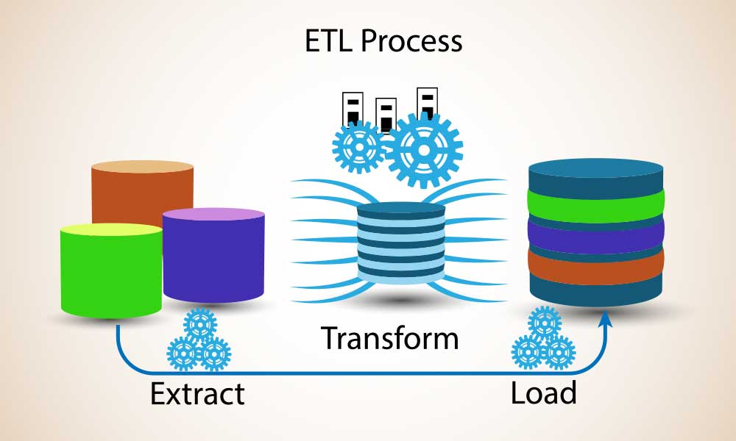

Slide 6


Extract
We extracted tables from the Real Estate Center at Texas A&M University
We also extracted excel files from the United States Census Bureau

Slide 7
Transform
To scrape tables we used Beautiful Soup
To import the csv file we used pandas
To convert the files to a data frame we used pandas as well.

Slide 8

Load
To load the files to a database MongoDB was used

